Slide 1

Sunrise Hospital
Analysis

Slide 2

AGENDA
Introduction
2. Objective
3. Dataset
4. Requests
5. Insights

Slide 3
Introduction
Sunrise Hospital is the leading healthcare Hospital in India with mission is to enhance the health and well-being through personalized and comprehensive medical services.

Slide 4
Objective
Doctors in Sunrise Hospital requests insights from data collected between year 2015 and 2023. The objective is to optimize improve patient outcomes and support informed decision-making within the healthcare institution.

Slide 5
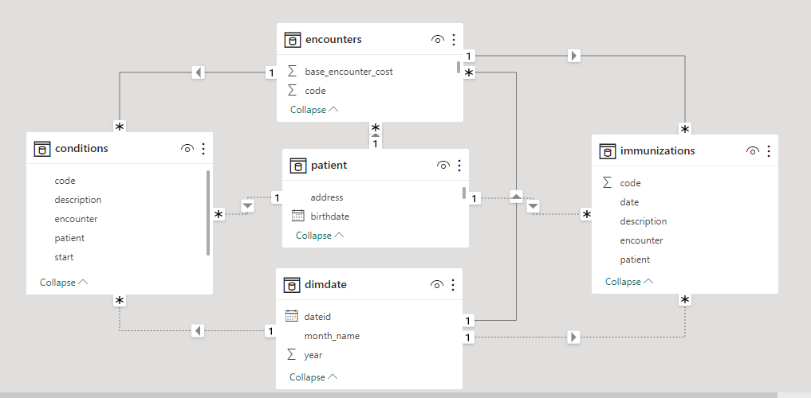


Dataset and modelling
Tools used

Slide 6




Request 1
Calculate total patient count from year 2015-2023
SQL
Power BI

Slide 7



Request 2
Calculate total immunization for year 2022
SQL
Power BI

Slide 8



Request 3
Calculate distinct condition for year 2019
SQL
Power BI

Slide 9
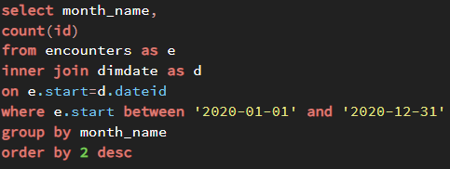
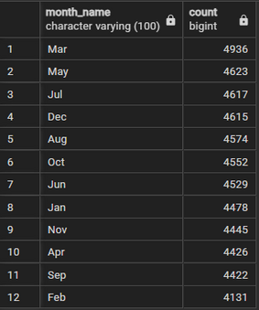
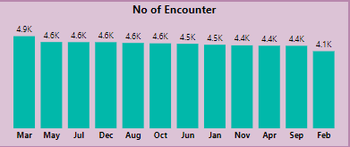
Request 4
Calculate no of encounters of each month for year 2020
SQL
Power BI

Slide 10
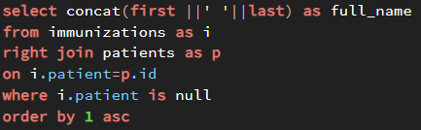
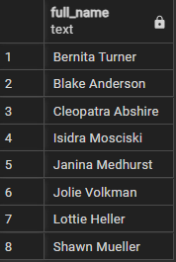
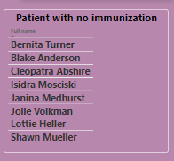
Request 5
Mention patient full name with no immunization
SQL
Power BI

Slide 11
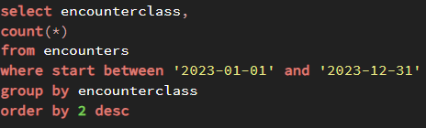
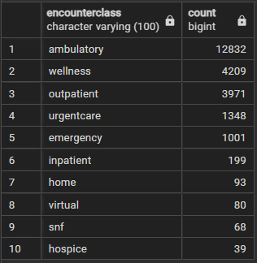
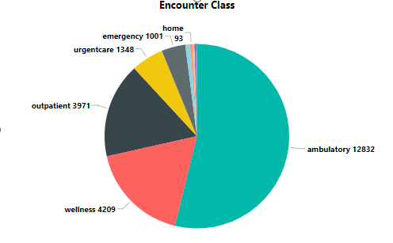
Request 6
Calculate encounterclass for year 2023
SQL
Power BI

Slide 12
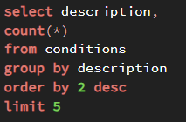
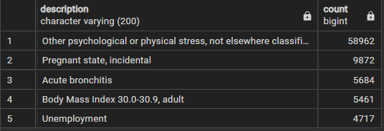
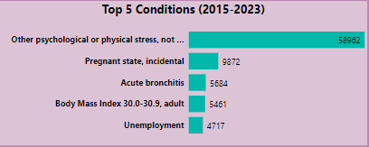
Request 7
Mention top 5 conditions from 2015-2023
SQL
Power BI

Slide 13

Insights
From total registered patients in Sunrise Hospital 8 patients has not taken any immunization
Most highest encounter class for year 2023 was Ambulatory
Pre-COVID year (2019) their were around 120 distinct conditions reported in Sunrise hospital
Other psychological and physical stress is top health condition between 2015-2023
Hospital provided total immunization of 14,074 in year 2022

Slide 14


